Slide 1
A Rhetorical Story: An OER Unit on Narrative Writing
Ron Christiansen and Clint Johnson
Salt Lake Community College
www.clintjohnsonwrites.com/tyca-west.html
Notes:
Ron’s background

Slide 2
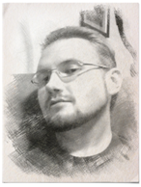
Notes:
This is me.

Slide 3
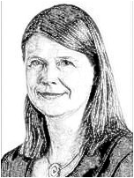
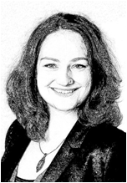
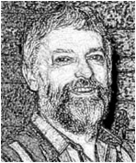
Susanne Kinnebrock
Augsberg University
Helena Bilandzec
Augsberg University
Creative Writing Theory
“…reduction in counterarguing…”
“…emotions seem to play the most important role…”
Agentless reading “independent of self”
David Miall
University of Alberta
Notes:
Creative writing theory: the primacy of uncritical reading and of emotion

Slide 4
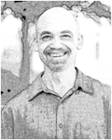
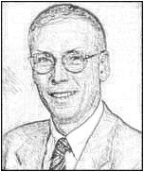
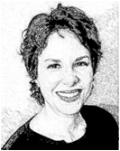
Susanne Kinnebrock
Augsberg University
Helena Bilandzec
Augsberg University
Creative Writing Theory
“…reduction in counterarguing…”
“…emotions seem to play the most important role…”
Agentless reading “independent of self”
David Miall
University of Alberta
Writing Center Theory
“… not in the terms of some
curriculum, but in terms of the
writers it serves…”
“Our job is to produce better
writers, not better writing…”
Neal Lerner
Northeastern University
Stephen North
University at Albany, SUNY
Beth Boquet
Fairfield University
Notes:
Writing Center Theory: the primacy of the writer
So that was my theoretical footing until I started teaching, when from my perspective rhetoric essentially gobbled up the world

Slide 5
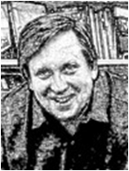
Rhetoric and Composition
Theory
Promotes “skepticism” and “mistrust”—“In the course that I teach, I begin by not granting the writer her ‘own’ presence in [a] paper.”
Susanne Kinnebrock
Augsberg University
Helena Bilandzec
Augsberg University
Creative Writing Theory
“…reduction in counterarguing…”
“…emotions seem to play the most important role…”
Agentless reading “independent of self”
David Miall
University of Alberta
David Bartholomae
University of Pittsburg
Writing Center Theory
“… not in the terms of some
curriculum, but in terms of the
writers it serves…”
“Our job is to produce better
writers, not better writing…”
Neal Lerner
Northeastern University
Stephen North
University at Albany, SUNY
Beth Boquet
Fairfield University
Notes:
The source of my personal crisis was well articulated by David Bartholomae in his famous debate with Peter Elbow about use of narrative in the comp classroom: a rhetorical view of language often promotes “skepticism” and “mistrust,” the antithesis of the uncritical experience I strove to create in my stories. And where my writing center experience taught me to put the writer at the center of their compositional universe, Bartholomae challenged: “In the course that I teach, I begin by not granting the writer her own presence in [a] paper.”

Slide 6
Rhetoric and Composition
Theory
Promotes “skepticism” and “mistrust”—”In the course that I teach, I begin by not granting the writer her ‘own’ presence in that paper.”
Susanne Kinnebrock
Augsberg University
Helena Bilandzec
Augsberg University
Creative Writing Theory
“…reduction in counterarguing…”
“…emotions seem to play the most important role…”
Agentless reading “independent of self”
David Miall
University of Alberta
David Bartholomae
University of Pittsburg
Writing Center Theory
“… not in the terms of some
curriculum, but in terms of the
writers it serves…”
“Our job is to produce better
writers, not better writing…”
Neal Lerner
Northeastern University
Stephen North
University at Albany, SUNY
Beth Boquet
Fairfield University
Notes:
Yeah, boom!
So these are the perspectives from which Ron and I approach a potentially transformational challenge now faced by our department

Slide 7
Question: How Do We Know What We Do, Do What We Intend, and Achieve What We Hope from Our Doings?
Notes:
The quest for pedagogical coherence.
History: genre-based structure; outcome-based structure; personal, textual, civic structure
OER Movement: Rejecting textbook and creating our own curriculum

Slide 8
SLCC Comp. Threshold Concepts
1. Language is a resource that we use to do things, say things, make things, and be things in the world. Rhetoric provides a method for understanding the work language does.
2. Writing is a form of social action. Through writing and textual practices we respond to exigencies and can create change in the world.
3. Writing is a process of deliberation. It involves enacting compositional choices, strategies and moves.
4. Writing becomes meaningful in context. People interpret texts (making them meaningful) in ways that depend on their own experiences, values systems and ways of knowing within various contexts.
5. Effective or meaningful writing is contingent on the situation, on the readers and on the text’s purposes/uses.
6. Effective or meaningful writing is achieved through sustained engagement in literate practices and through revision.
Notes:
Threshold concepts form the spine of the scope and sequence across 1010 and 2010: what experiences are students having in our classes and what from those experiences are we expressly foregrounding?
Online Plus: Hybrid 1010 and 2010 classes piloting the curriculum and doing much of the text creation

Slide 9
Question: Do Rhetorical Threshold Concepts Make Us a Rhetoric Department?
Notes:
Questions to ascertain information about the audience

Slide 10
Story: “The Professor Who Hid a Secret”
Notes:
7.5 minutes

Slide 11
Story: “The Professor Who Hid a Secret”
To narrate our lives is to admit to a point of view, to ground our arguments in the lived experience of who we are...
Notes:
7.5 minutes

Slide 12
Story: “The Professor Who Hid a Secret”
Irene Papoulis: “I find it amazing to think that so many years later I still strive to argue for storytelling as a form of analysis, and I still carry a nagging sense of shame about that, a murmur of ‘you’re touchy-feely, you’re not rigorous enough’...”
Notes:
7.5 minutes

Slide 13
Story: “The Professor Who Hid a Secret”
...Newkirk argues that “there is a conflict between the ways we treat narrative in school (as a type of writing, often an easy one) and the central role narrative plays in our consciousness”...
Notes:
7.5 minutes

Slide 14
Story: “The Professor Who Hid a Secret”
...Newkirk contends that “Narrative is a form or mode of discourse that can be used for multiple purposes…---we use it to inform, to persuade, to entertain, to express. It is the ‘mother of all modes,’ a powerful and innate form of understanding”...
Notes:
7.5 minutes

Slide 15
Story: “The Professor Who Hid a Secret”
...His identity disturbed my sense of order as I wrote, “For two semesters I’ve been fascinated with understanding Dr. Bach’s soul--why is he such a good teacher? What makes him such a good Christian (a person I respect), so understanding and non-judgmental… without the gospel of Christ I hold so dearly?”...
Notes:
7.5 minutes

Slide 16
Story: “The Professor Who Hid a Secret”
...As I have admitted the very argument I am making in this essay actually supports how I see myself as an academic--it argues that my, sometimes, confessionary and autobiographical academic work counts as much as the traditionally sounding objective academic work...
Notes:
7.5 minutes
And Ron’s story has unexpectedly come to you through me, and now that the argument is made, what next? I don’t know. As I said, this story and the essay within it are both still being written, so we can consider this a cliffhanger.

Slide 17
And now for something completely
different!
Notes:
These tensions Ron has narrated are catalyzed by teaching a narrative unit in a composition sequence with a rhetoric studies skeleton and easily seen through an X-ray machine of rhetorical theory. It’s very easy to see how something not expressly familiar as part of the skeleton can be part of a functioning, living body. We all define rigor in our own image. It’s tempting to assume that in which our expertise allows us to evaluate many gradations in performance is rigorous.
Our curricular move toward pedagogical coherence has challenged us to use threshold concepts to revise our teaching praxis--but we believe it has also given us a common language by which to argue for the pedagogical value, and yes, even rigor, of our narrative unit.

Slide 18
Notes:
Slides 7-16 are my 5-minute (I hope!) presentation of our week 3 curriculum. I’d appreciate it if you’d take a look at see if you’re okay with how texts from the class are being represented of if you feel we may need something else, maybe accenting the digital presentation with hard copies or something.

Slide 19
Self Study: Week 3
Discuss content and organization of self study. Review the student examples for content and organization. Have students map out or outline their own projects. Help facilitate their thinking about content and organization in ways that work for your teaching practice.

Slide 20
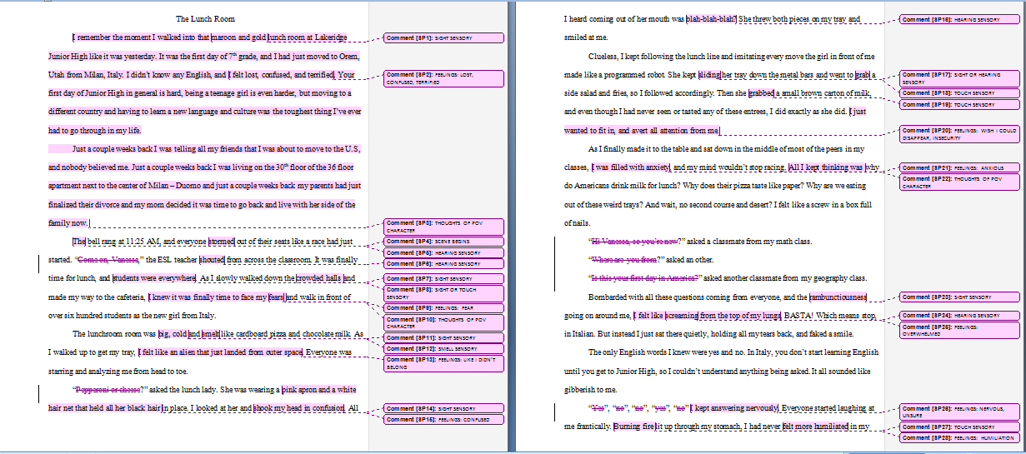
Narrative Unit: Week 3 Genre Study

Slide 21
Narrative Unit: Week 3 Genre Study
So it is ironic indeed that I now embark on a story about my teaching in order to make a somewhat academic argument for a particular way of seeing and using stories in the writing classroom.
Monisha Pasupathi, a professor of developmental psychology at the University of Utah, suggests “What really matters isn’t so much whether it’s true in the forensic sense, in the legal sense,” instead “What really matters is whether people are making something meaningful and coherent out of what happened” (qtd in Heritage Day: The Importance of Life Stories).

Slide 22
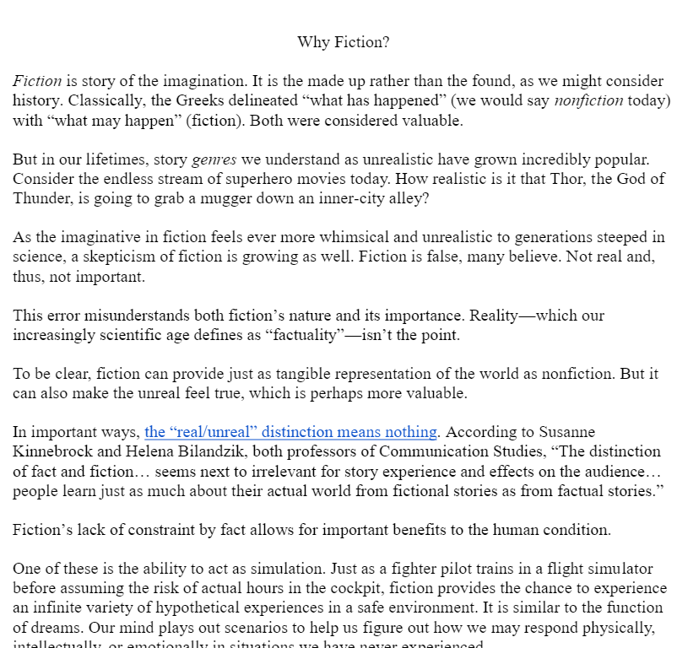
Narrative Unit: Week 3 Genre Study
According to Susanne Kinnebrock and Helena Bilandzik, both professors of Communication Studies, “The distinction of fact and fiction… seems next to irrelevant for story experience and effects on the audience… people learn just as much about their actual world from fictional stories as from factual stories.”
In the last decade, research has shown that mirror neurons—neurons that fire both when an animal acts and witnesses an action—respond to fiction. Thus, in the brain’s terms, reading a fictional action can be as real as performing that action in real life.

Slide 23
Narrative Unit: Week 3 Genre Study
What do you see as unique about the narrative genre you've chosen? Why is it important that stories in this genre be told?
Given all you've learned about your genre, what do you think most recommends your Flash Narrative concept? What will a reader take away from the experience of reading it? What will the reward be? What will interest them so powerfully they cannot put the story down?

Slide 24
Narrative Unit: Week 3 Genre Study

Slide 25
Narrative Unit: Week 3 Genre Study
“The connection I can make between stories I've encountered this week, and with what I've learned in school about narrative, is what normal healthy adults have in common. That they can all produce a life story. They can all put one together. In order to have human connections, we all have to tell little pieces of our story. And so it’s hard to be a human being and have relationships without having some version of a life story floating around.”

Slide 26
Narrative Unit: Week 3 Genre Study
“Before starting this course I didn’t see the applications of stories throughout human history and even in our daily lives today as I do now. Stories are a necessary facet of what makes us human. We learn, grow, adapt, change, and communicate through them and their abundance is staggering. I find it incredible that we subconsciously take lessons from stories even in the forms of things as simple as 30 second Youtube videos and apply them to our own lives. There really are stories everywhere you look!... A story isn’t so much about what is in it, but what can be taken from it.”

Slide 27
Narrative Unit: Week 3 Genre Study
“The pieces that we read such as ‘You’ll never believe what happened’ and ‘What is story’ really helped me take a hard look at why we as humans write. Before this class I really just thought of writing as a hobby. Some people do it more than others and like-wise some love it more than others. But after 5 weeks in this class I have realized that stories and writing are how we express ourselves as humans. By coming to that realization it has helped me to be more passionate and actually care about what I have been writing rather than just doing the work to get a grade. After reading these pieces and really looking back at the way I tell stories to people, it changed the way that I wrote my narrative draft. I looked deeper into myself to find the emotions that were really happening in that situation and tried to use those to appeal to the reader’s emotions.”
Notes:
Slides 2-6 are my personal pedagogical context. I’m assuming your personal context will go before this section.

Slide 28
www.clintjohnsonwrites.com/tyca-west.html
“Is that a true story?” - The role of fact in nonfiction
“You will never believe what happened…” - Narrating as a way to be in the world
2 versions of “Why Fiction?” - Fiction’s role in the human experience
“What Is Story?” - Theory of story as mechanism for making meaning, a genre and mode, an understanding of identity, and a rhetorical act
Slides from this presentation
Ron: ron.christiansen@slcc.edu
Clint: clint.johnson@slcc.edu

